Slide 1
Progressive Network-Flow Based Power-Aware Broadcast Addressing
for Pin-Constrained Digital Microfluidic Biochips
2011 IEEE/ACM Design Automation Conference (DAC’11)
Tsung-Wei Huang, Hong-Yan Su, and Tsung-Yi Ho
http://eda.csie.ncku.edu.tw
Department of Computer Science and Information Engineering
National Cheng Kung University
Tainan, Taiwan

Slide 2
Digital Microfluidic Biochips (DMFBs)
Digital Microfluidic Biochips
  Droplets: biological sample carrier; basic units to perform the laboratory procedures on DMFBs
  2D microfluidic array: set of basic cells for biological reactions
  Reservoirs/dispensing ports: for droplet generation
  Optical detectors: detection of reaction result
Droplet
Spacing
2D microfluidic array
Photodiode
Droplets
High voltage to generate an electric field
(b)
Hydrophobic insulation
Ground
electrode
Control
electrodes
Optical detector
Top plate
Droplet
Filler medium
Dispensing ports
Bottom plate
(a)
(c)

Slide 3
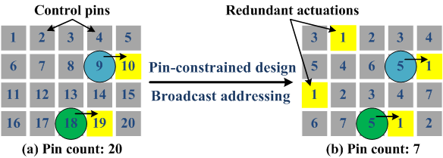
Electrode Addressing and Pin-Constrained DMFB
Electrode addressing
  A means to identify the input signal of each electrode by pin
Direct-addressing DMFB
  Dedicated and independent control pin for each electrode
  Maximum freedom of droplets
  High pin count for large design with high manufacturing complexity
Broadcast-addressing DMFB
  Multiple electrodes are addressed by a control pin
  Control signal/pin sharing
  Flexible for pin-constrained DMFBs (PDMFBs)
  Redundant actuation problem
Influence of redundant actuations
Power-consumption problem
Decreasing battery lifetime
Decreasing electrode lifetime

Slide 4
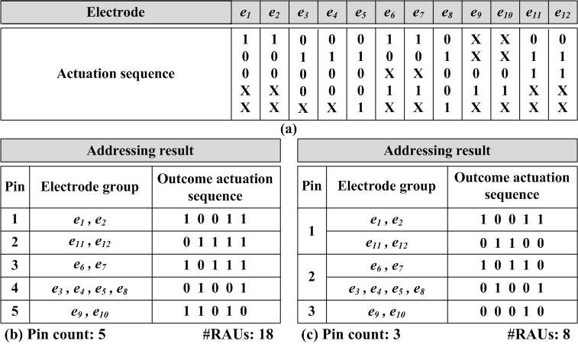
Broadcast Electrode Addressing
Fluidic-control information in the form of actuation sequences
  “1” (“0”) represents a control signal with a relatively logic-high (logic-low) value of the actuation voltage
  The symbol “X” indicates that the input signal can be “1” or “0”
  Reduces the pin count by replacing “X” with “1” or “0” to make multiple electrodes share the same control signal
  Compatibility is examined for identical and complementary signals

Slide 5
Problem Formulation
Definition
  RAU: redundant actuation unit (i.e., resulted from the replacement of “x” with “1”)
Input
  A set of electrodes and the corresponding actuation sequences
Constraint
  Broadcast addressing constraints: an electrode set can be addressed with the same control pin if and only if their corresponding actuation sequences are mutually compatible
Objective
  Deriving an low-power addressing result without any constraint violation
  Minimizing the number of control pins while keeping the resulted number of redundant actuation units (RAUs) minimized

Slide 6
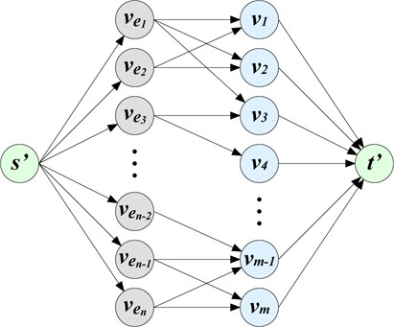
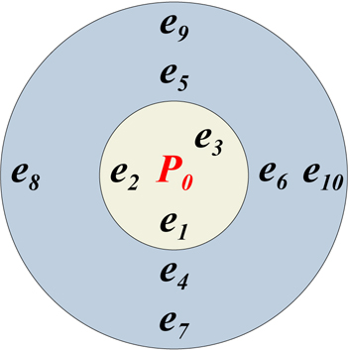
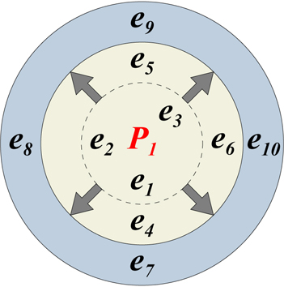
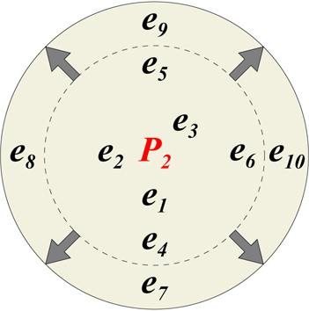
Algorithm (1/2) – Progressive Addressing Scheme
Progressive addressing scheme
  Reducing the design complexity by deriving several addressing subproblems
  Iteratively selecting a maximum non-compatible electrode group (from unaddressed electrode set)
    Facilitating the flow formulation
  Minimizing the pin count and power consumption
MCMF network
* Progressively including an unaddressed electrode group
for addressing
* Iterations end until all electrodes are addressed
Unaddressed
electrodes
Existing
pins
Objective in each subproblem iteration:
Maximizing the number of using existing pins for addressing → maximum flow value
Minimizing the number of RAUs for addressing → minimum flow cost

Slide 7
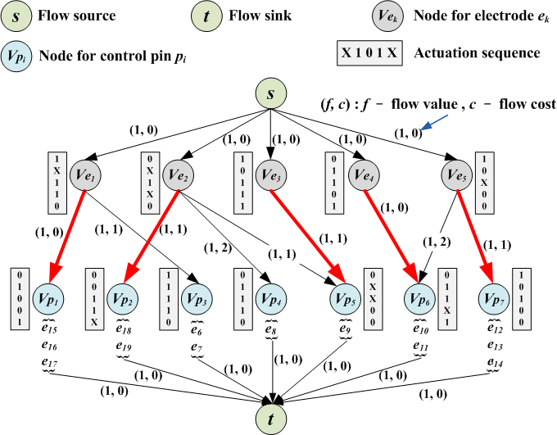
Algorithm (2/2) Minimum-Cost Maximum-Flow (MCMF) Model
MCMF idea:
Electrode set
1-1
Matching
Pin set

Slide 8
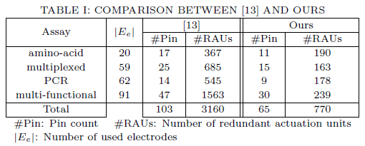
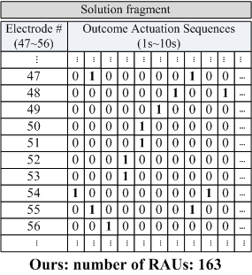
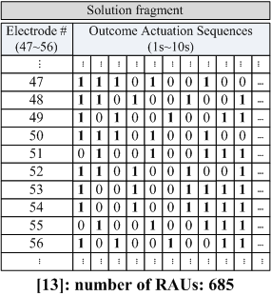
Experimental Results
Implementation
  C++ language on Linux platform with16GB Memory
Compared with the basic broadcast addressing [13] *
Multiplexed result example:
Four real-life assays of amino-acid, multiplexed, PCR, and multi-functional assays
(1) 37% pin-count reduction
(2) 76% RAU-count reduction
* [T. Xu and K. Chakrabarty, DAC’08] [13]

Slide 9
Thank You!

